Slide 1



IPL Data Visualization
By Abhijeet Kumar

Slide 2
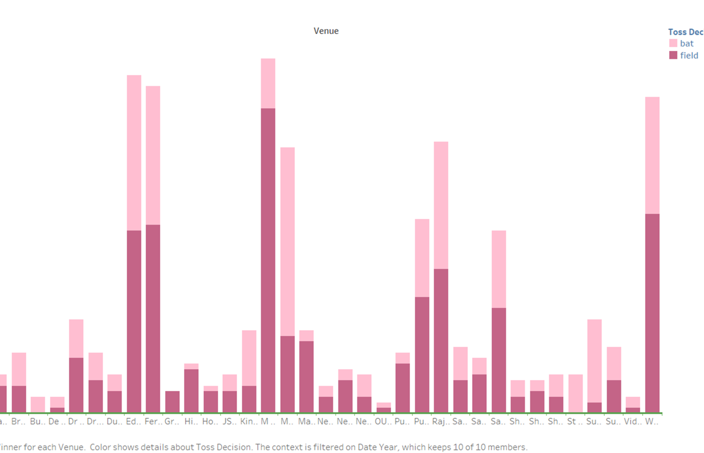
Chart Description:
The chart displays the count of match wins based on the toss decision (bat first or field first) at various cricket venues.
Each venue has two sets of bars: one for matches where the toss winner chose to bat first (indicated by orange bars) and another for matches where the toss winner chose to field first (indicated by blue bars).
Key Insights:
Overall Trend:
Across most venues, teams that chose to field first have a higher number of wins.
Opting to chase seems advantageous, especially in high-pressure matches.
Venue-Specific Patterns:
Some venues show significant differences in outcomes based on toss decisions.
For example:
At Eden Gardens, teams choosing to field have a clear advantage.
However, at Wankhede Stadium, both toss decisions lead to comparable wins.
Toss V/S Match Outcomes

Slide 3
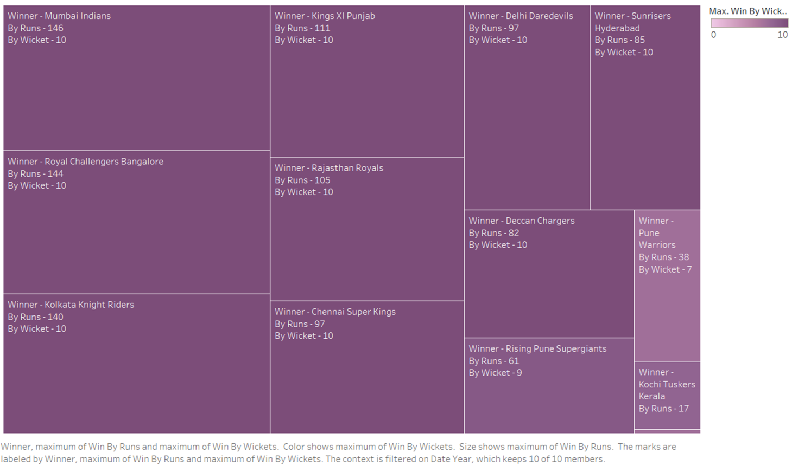
Biggest Wins by runs and wickets
Biggest Wins by Runs:
Mumbai Indians (MI) achieved the most significant victory by runs, winning a match by a whopping 146 runs.
Kolkata Knight Riders (KKR) secured the second-largest win by runs, with a margin of 146 runs.
Royal Challengers Bangalore also had an impressive win by 144 runs.
These victories highlight dominant batting performances where teams successfully defended large totals.
Biggest Wins by Wickets:
The teams listed in this column achieved victories without losing any wickets, which is considered a perfect chase.
The value “10” next to each team indicates that they won by chasing down the target with all wickets intact.
Notable teams achieving this feat include Sunrisers Hyderabad, Royal Challengers Bangalore, and Rajasthan Royals.
Other Teams:
Teams like Deccan Chargers and Rising Pune Supergiants also feature in the table, but their biggest wins are less substantial compared to the top performers.

Slide 4
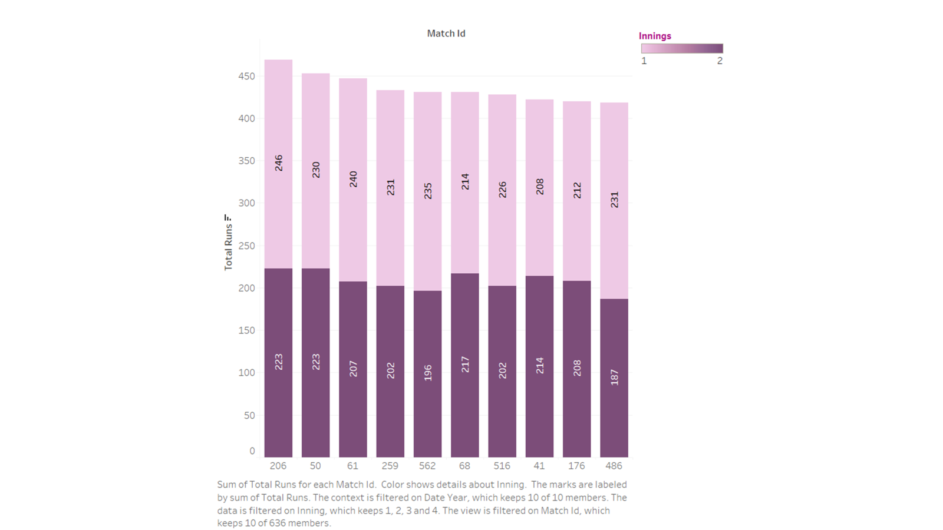
Highest Totals
Mumbai Indians (MI) achieved the highest total of 450 runs in a match.
Royal Challengers Bangalore (RCB) also scored an impressive 400 runs in a different match.
Other notable high totals include 350, 300, and 250 runs by various teams.

Slide 5
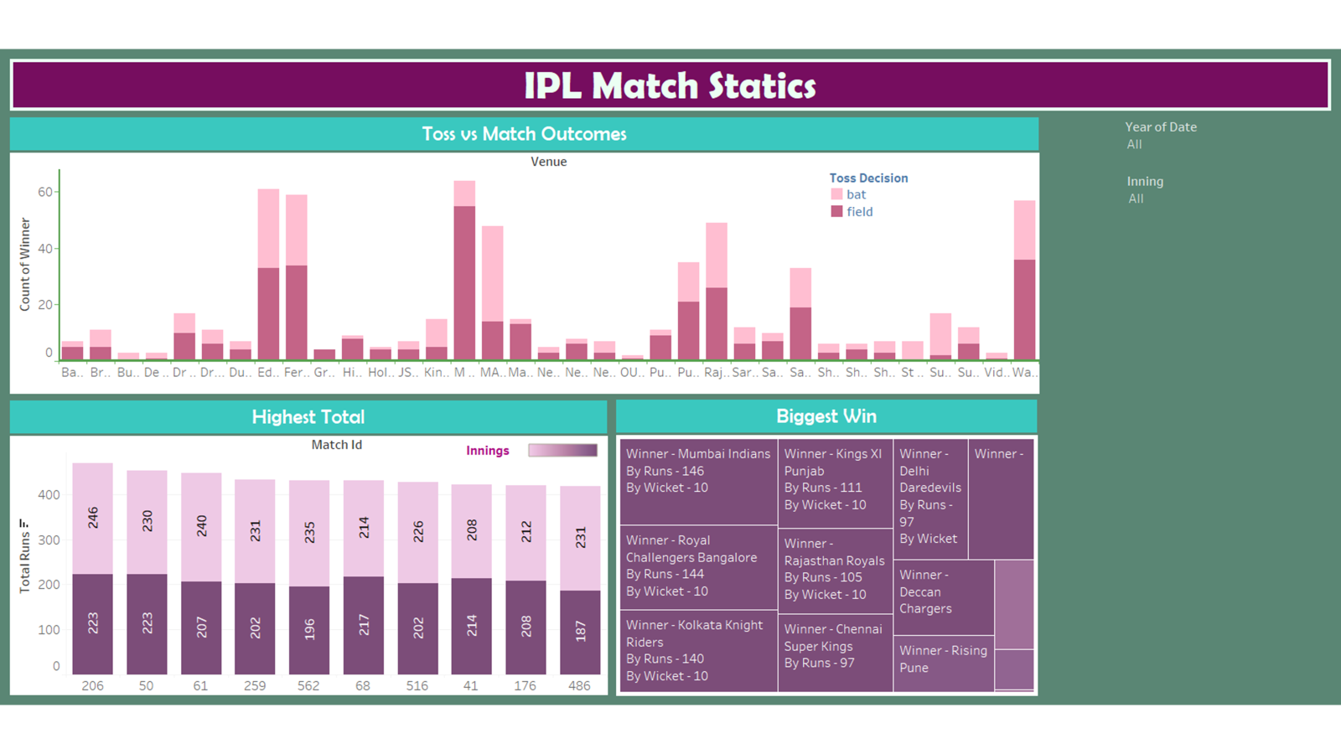
Toss vs. Match Outcomes:
The correlation between winning the toss and winning the match varies across venues.
Some venues show a strong connection, while others do not.
Further analysis is needed to understand the impact of the toss on match results.
Highest & Lowest Total:
Match IDs with extreme total scores are listed.
The highest total recorded is 259, while the lowest is 41.
Investigate factors contributing to high or low scoring games.
Biggest Wins:
Matches with significant winning margins (by runs or wickets) are highlighted.
For example, one match was won by 145 runs, and another by 10 wickets.
Explore dominant performances in terms of runs or wickets.

Slide 6
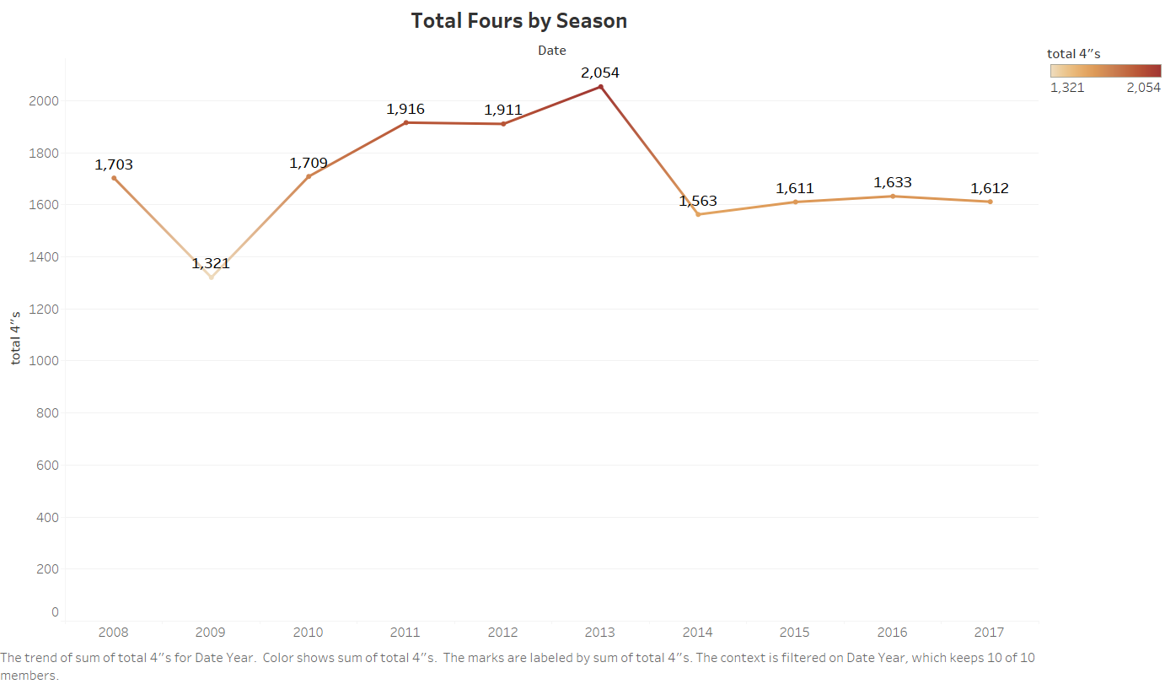
The Total Fours by Season chart in the Indian Premier League (IPL) provides insights into boundary scoring trends over different seasons. Here are the key takeaways:
Peak Fours:
The graph peaks in two seasons: 2011 with a total of 1,916 fours and 2013 with a record-breaking 2,054 fours.
These seasons witnessed aggressive batting and frequent boundary hits.
Dip After 2013:
After 2013, there is a noticeable dip in the number of fours hit.
Teams may have focused on other scoring strategies or faced stronger bowling attacks.
Inaugural Year (2008):
The lowest point on the graph is in the first IPL season (2008), with only 1,324 fours.
Teams were still adapting to the T20 format, resulting in fewer boundaries.
Overall Trend:
Despite fluctuations, the overall trend shows an increase in boundary scoring over the years.
Aggressive batting and innovative shots have become integral to IPL matches.
Total Fours by Season

Slide 7
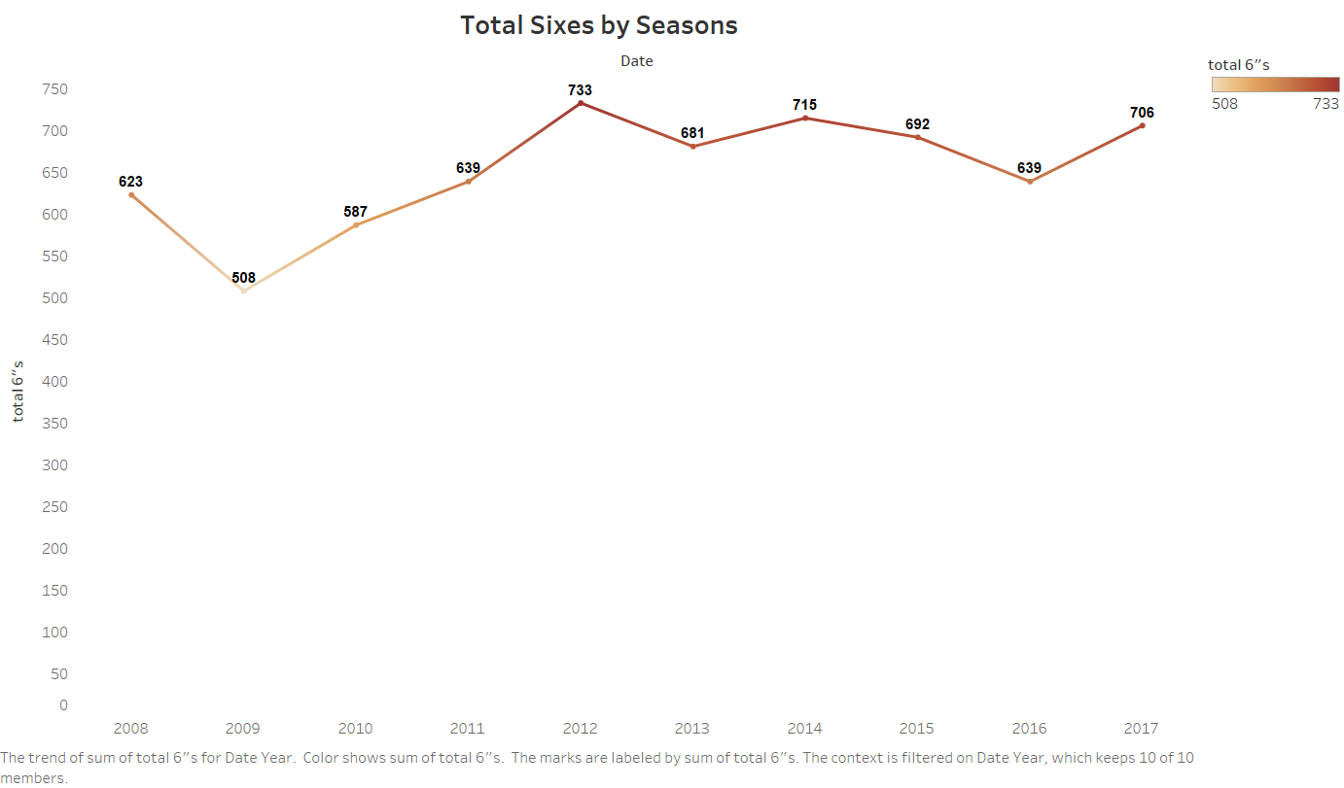
Total Sixes by Seasons
The Total Sixes by Seasons chart in the Indian Premier League (IPL) provides insights into the number of sixes hit during different seasons. Here are the key takeaways:
Peak Sixes:
The graph shows an upward trend in the total number of sixes hit over the years.
The highest number of sixes was recorded in 2012, with approximately 733 sixes.
Fluctuations:
After the peak in 2012, there is a slight dip in the number of sixes hit in subsequent seasons.
However, overall, aggressive batting and power hitting have become more prevalent in IPL matches.
Seasonal Variation:
Each season has its own dynamics, influenced by player form, pitch conditions, and team strategies.
The data suggests that players have increasingly targeted boundaries, aiming for maximum runs.

Slide 8
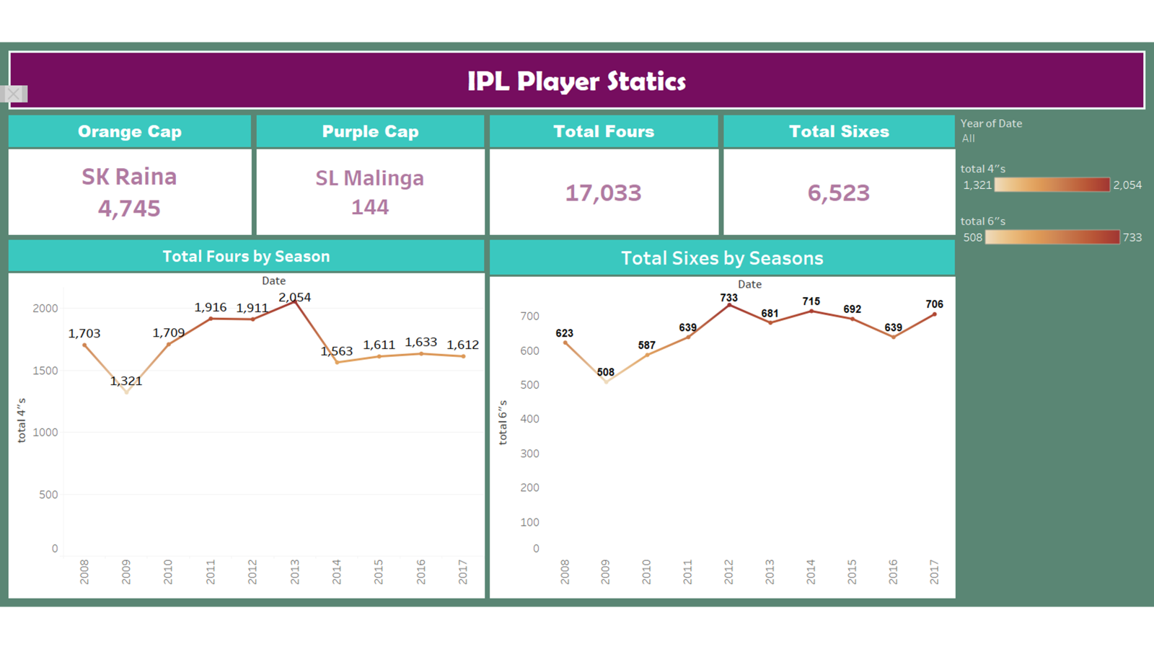
The IPL Player Statistics chart provides valuable insights into player performances in the Indian Premier League (IPL). Here are the key takeaways:
Orange Cap and Purple Cap:
The “Orange Cap” represents the player with the highest total runs in a season. Suresh Raina held this title with a remarkable 4,745 runs.
The “Purple Cap” signifies the player with the most wickets. SL Malinga achieved this feat, taking a total of 144 wickets.
Boundary Scoring Trends:
The chart includes two sections:
Total Fours by Season: This bar graph shows the number of fours hit each season. The highest number of fours was in 2012, with approximately 733 fours.
Total Sixes by Seasons: Similar to the fours chart, this graph represents the number of sixes hit. The trend shows an overall increase in sixes over the years.
Overall Insights:
Aggressive batting and power hitting have become integral to IPL matches.
Players aim for boundaries, contributing to the league’s entertainment value.

Slide 9
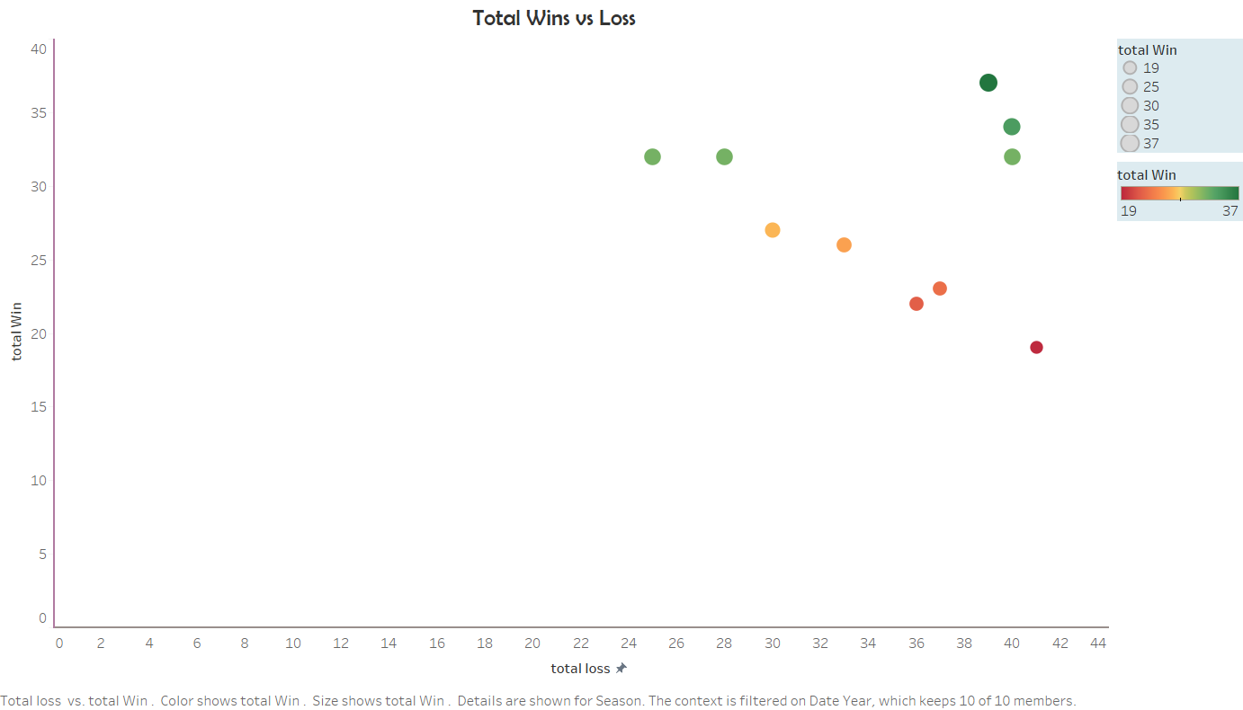
The scatter plot graph based on IPL data illustrates the relationship between total wins and total losses for different teams. Here are the key insights from the chart:
Team Performance Clusters:
The data points cluster into distinct regions. Teams with similar win-loss records tend to group together.
Notably, there’s a dense cluster of teams with moderate wins and losses, forming a diagonal line from the bottom left to the top right.
High-Performing Teams:
The largest green dot represents a team with over 37 total wins and around 39 losses.
Teams with more wins are positioned toward the upper right corner, indicating their strong performance.
Low-Performing Teams:
The lower left corner contains smaller red dots, representing teams with fewer wins and more losses.
Teams with less favourable win-loss records are closer to the origin.
Outliers:
There are a few outliers: teams that significantly deviate from the general trend.
These outliers could be teams that had exceptional seasons or faced unique circumstances.
Total wins V/S Loss

Slide 10
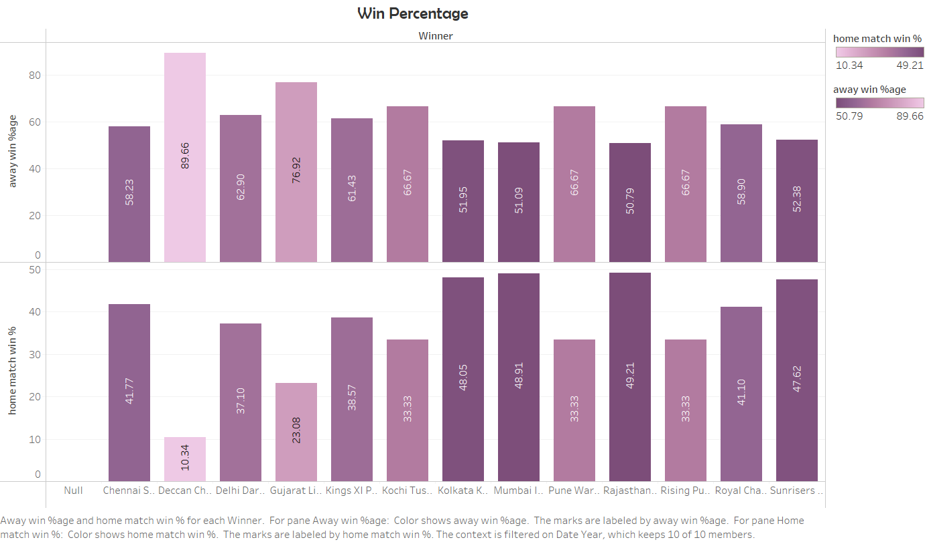
Home Match Win Percentage:
Teams generally have a higher win percentage in home matches.
Mumbai and Chennai exhibit significantly high home match win percentages.
Kochi has the lowest home match win percentage, indicating challenges when playing on their home ground.
Away Match Win Percentage:
Hyderabad stands out with the highest away match win percentage among all teams.
Some teams, like Gujarat and Pune, have relatively balanced win percentages in home and away matches.
The variation between home and away win percentages suggests that factors like familiar conditions and crowd support influence team performance.
Overall Insights:
Teams should capitalize on home advantage to boost their win percentages.
Analyzing away match strategies can help improve overall performance.
Consider venue-specific tactics based on historical win percentages.

Slide 11
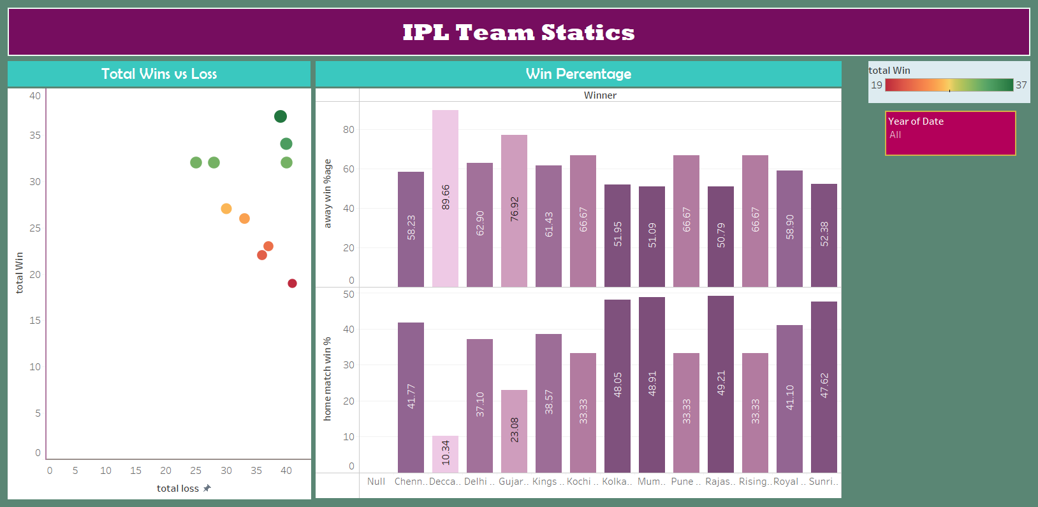
Home Match Win Percentage:
Teams generally have a higher win percentage in home matches.
Mumbai and Chennai exhibit significantly high home match win percentages.
Kochi has the lowest home match win percentage, indicating challenges when playing on their home ground.
Away Match Win Percentage:
Hyderabad stands out with the highest away match win percentage among all teams.
Some teams, like Gujarat and Pune, have relatively balanced win percentages in home and away matches.
The variation between home and away win percentages suggests that factors like familiar conditions and crowd support influence team performance.
Overall Insights:
Teams should capitalize on home advantage to boost their win percentages.
Analyzing away match strategies can help improve overall performance.
Consider venue-specific tactics based on historical win percentages.

